Slide 1
Bangla Handwritten Numeral Character Recognition Using Directional Pattern
20th International Conference On Computer and Information Technology (ICCIT 2017)December 22-24, University of Asia Pacific, Dhaka, Bangladesh
Article ID: 306
§Talha Ibn Aziz, ^{δ}Shahriar Rubel, ∂Md. Sirajus Salekin and ∫Rafsanjany Kushol
^{§δ∫}Department of Computer Science and Engineering, Islamic University of Technology, Dhaka, Bangladesh
∂ Department of Computer Science and Engineering, University of South Florida, Florida, United States

Slide 2



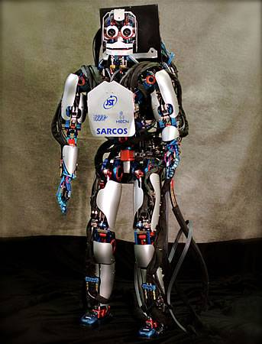
Contents
Introduction
Bangla Character Recognition
Steps of HCR
Directional Pattern
Proposed Method
Experimental Analysis
Conclusion
References

Slide 3

Introduction
Handwritten Character Recognition recognizes characters from images of handwriting.
Many Applications like
Automated License plate Identification
Teach Machines to read (Literally)
Automated Recognition
CLEAN UP YOUR MESS

Slide 4
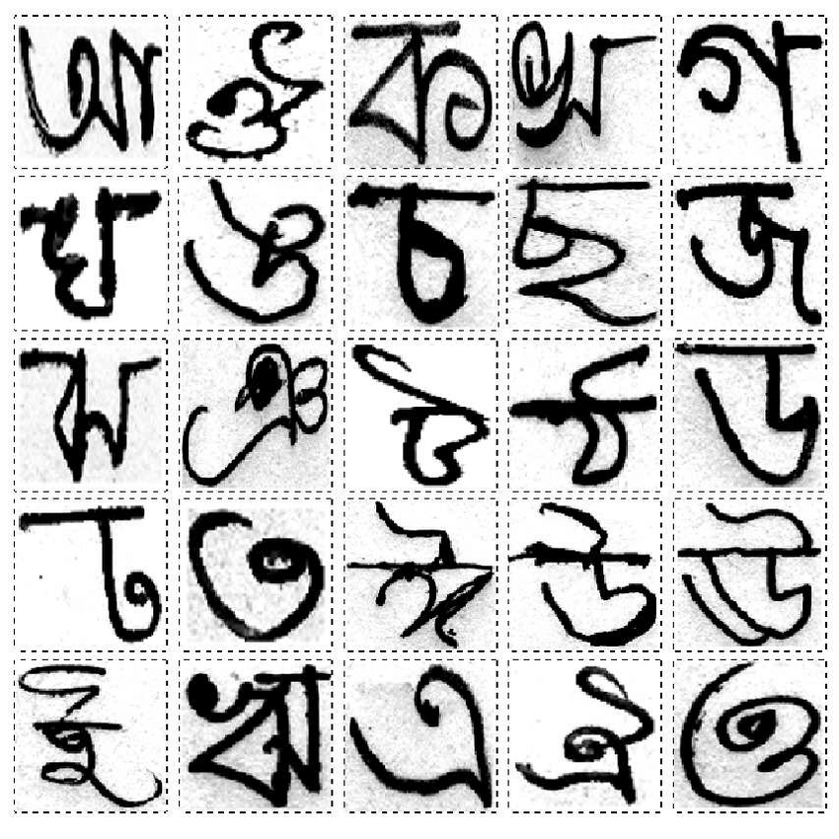


Bangla character recognition
A bit more complex than English
Previous Lack of Database
Notable Databases
ISI [1]
CMATER [2]

Slide 5
Bangla character recognition Databases
Indian Statistical Institute
Different databases containing
About 56000 digit images (23392 Bangla)
Bangla and Devnagari character images
Bangla Vowel Modifiers and Compound Characters
https://www.isical.ac.in/~ujjwal/download/database.html
Center for Microprocessor Applications for Training Education and Research
Computer Science and Engineering Department, Jadavpur University, Kolkata 700032, INDIA.
Images of English, Bangla and Hindi characters and words (6000 Bangla digits)
Weather, business cards etc. Images also
http://www.cmaterju.org/cmaterdb.htm

Slide 6
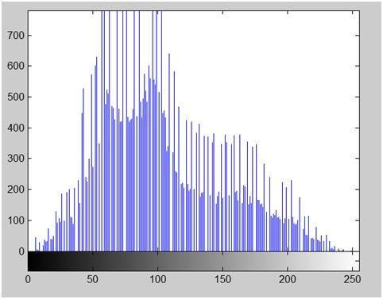
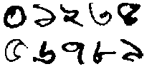
Steps of hcr
Preprocessing
Classification
Classifies the feature data into letters/numerals
Examples: KNN[15],SVM[16] etc.
Feature Extraction
Performs operations for better results like noise reduction, size fixes etc.
Collects the best features for better classification
Examples: GDP[12], LDP[11], LBP
Makes the Database data meet algorithm requirements
Makes Classification easier for the classifier removing unnecessary information
This is the final step after which we get what we 'really' want
০ ১ ২ ৩ ৪
৫ ৬ ৭ ৮ ৯

Slide 7
Directional Pattern
Focuses on its surroundings more
Well Known Facial Recognition Algorithm
Applies Masks/Kernels to Images
Some Notable Papers
We used GDP and LDP

Slide 8
Our proposed Method
We divided the image into blocks
We used Local Directional Pattern and Gradient Directional Pattern
LDP applies Kirsch Masks on Images
GDP uses Sobel Kernel and works with Gradient
We Got THREE results and Combined them
GDP + KNN
LDP + KNN
LDP + SVM

Slide 9


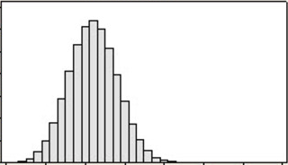
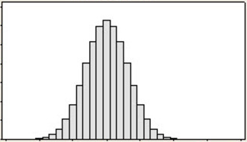
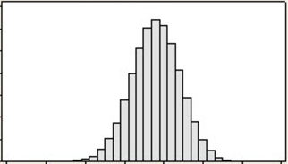
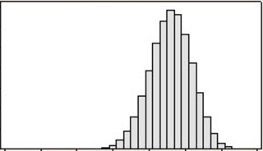
Image
Zones
Classifier
(KNN, SVM)
Result
Feature
DP
Method Flow Chart

Slide 10
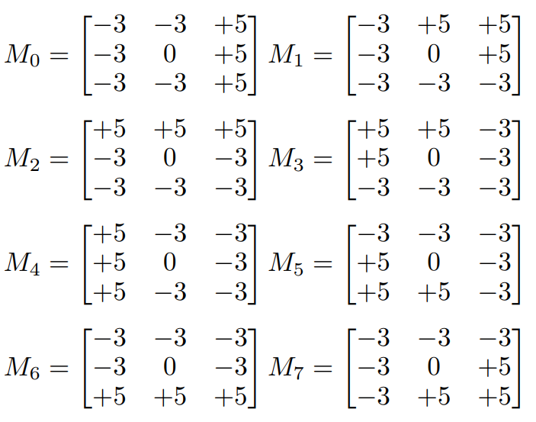
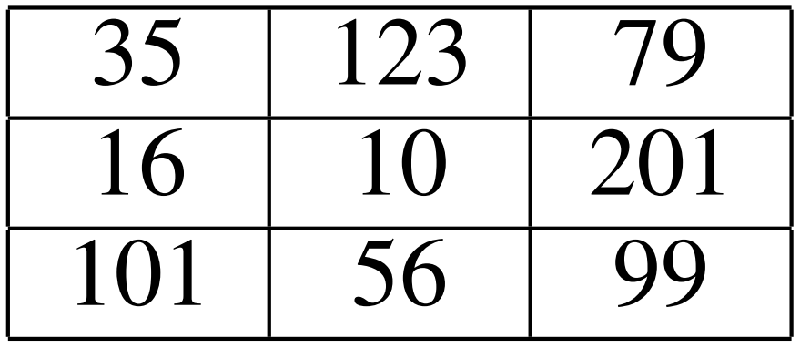
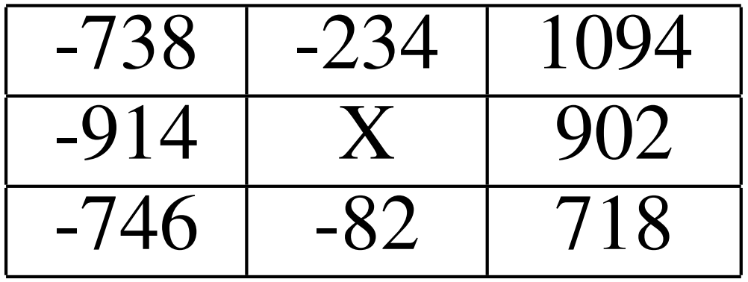
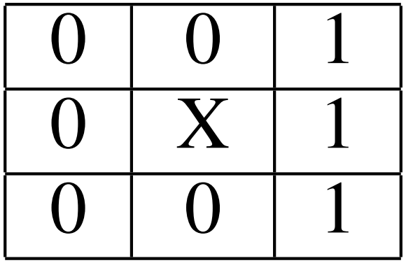
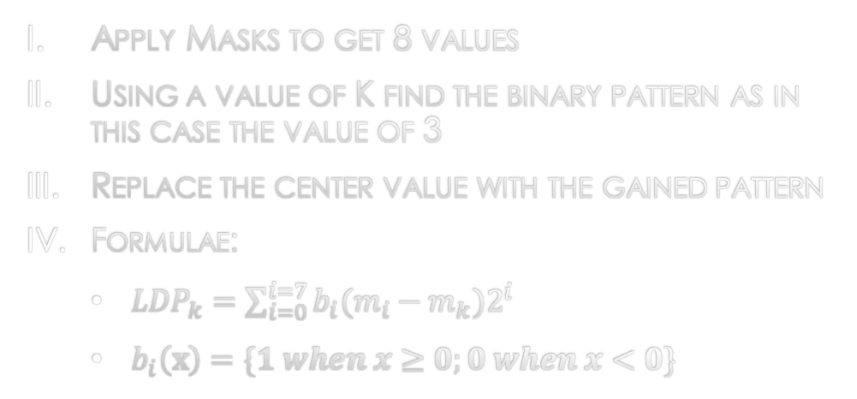
Local directional pattern
Apply Masks to get 8 values
Using a value of K find the binary pattern as in this case the value of 3
Replace the center value with the gained pattern
Formulae:
${LDP}_{k}=\sum_{i=0}^{i=7}{b_{i}(m_{i}−m_{k})2^{i}}$
$b_{i}\left(x\right)=\{1 when x≥0;0 when x<0\}$
Kirsch Masks
Masks
K High

Slide 11
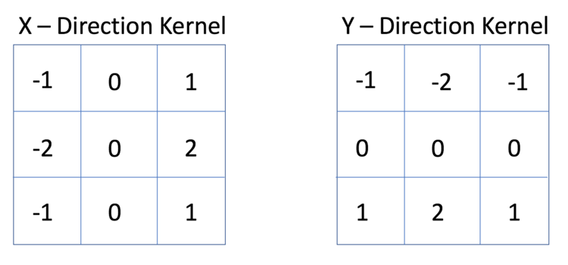
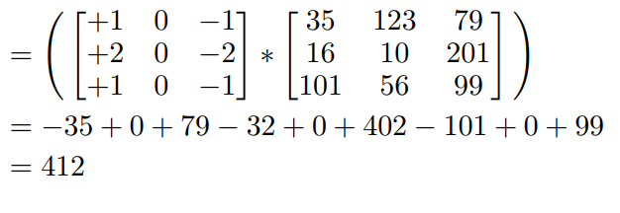
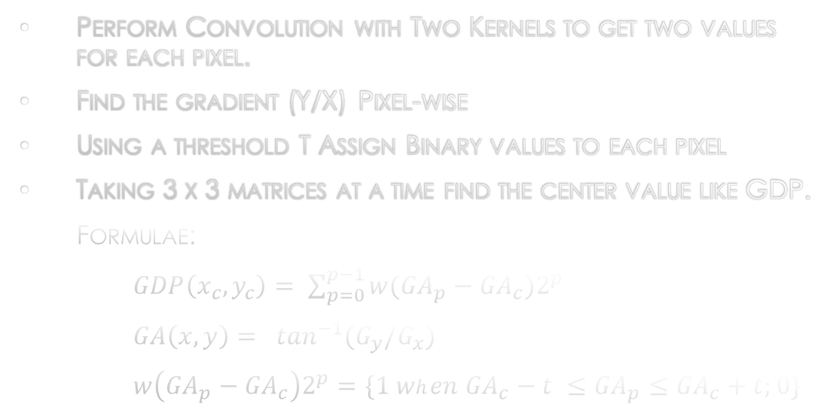
Gradient Directional Pattern
Perform Convolution with Two Kernels to get two values for each pixel.
Find the gradient (Y/X) Pixel-wise
Using a threshold T Assign Binary values to each pixel
Taking 3 x 3 matrices at a time find the center value like GDP.
Formulae:
$GDP\left(x_{c},y_{c}\right)= \sum_{p=0}^{p−1}{w({GA}_{p}−{GA}_{c})2^{p}}$
$GA\left(x,y\right)= \tan^{−1}(G_{y}{/G}_{x})$
$w\left({GA}_{p}−{GA}_{c}\right)2^{p}=\{1 when {GA}_{c}−t ≤{GA}_{p}≤{GA}_{c}+t;0\}$

Slide 12
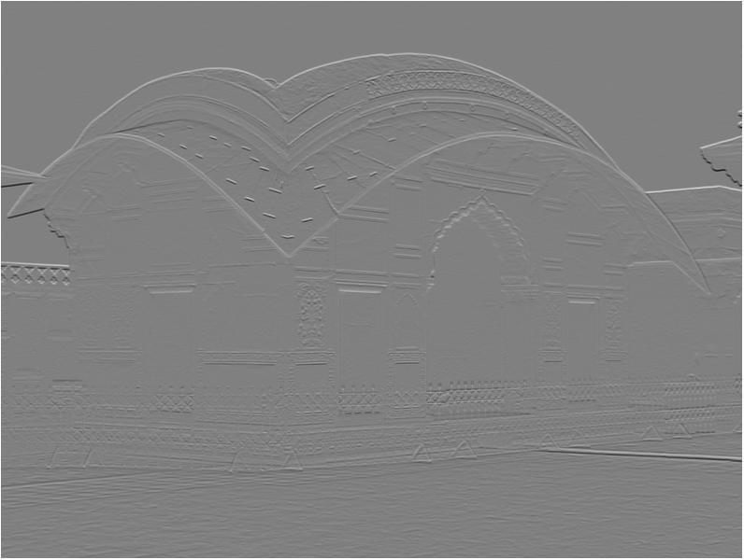
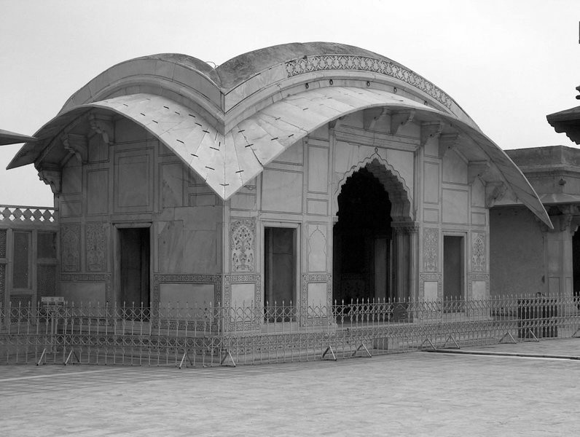
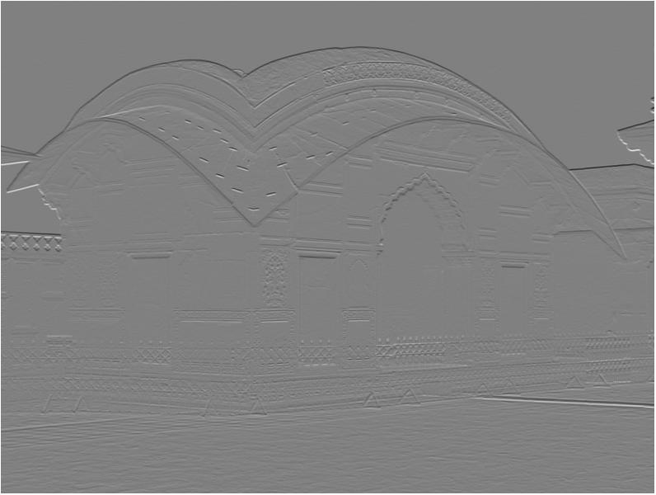
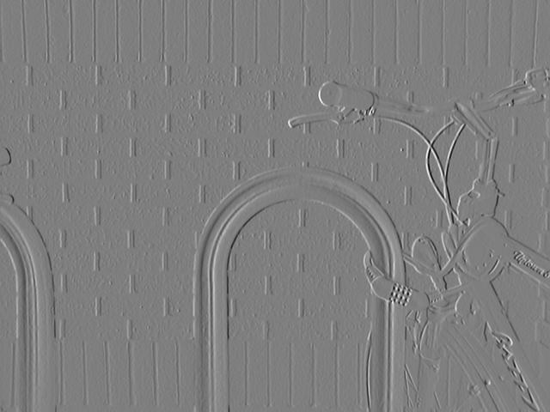
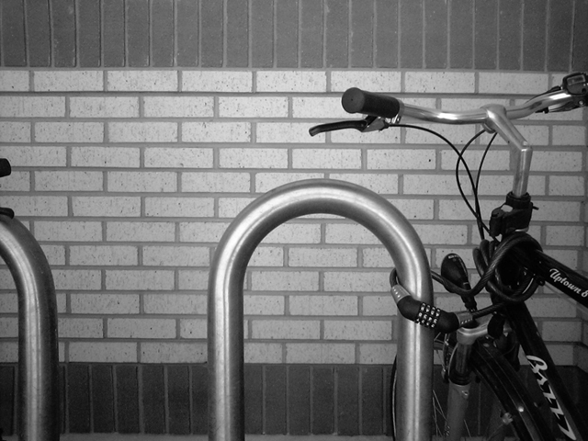
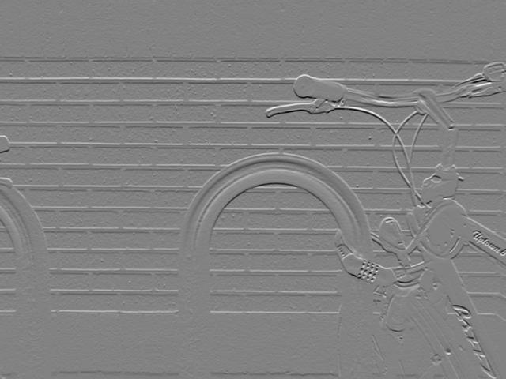
North Mask (2)
South Mask (6)
Original Image
X grad
Y grad

Slide 13
Experimental analysis
We formed different blocks of the whole image and created some zone sets.
We Applied our Proposed Directional Patterns on each block separately.
We formed a histogram count of length 256 (highest value) for each block and used all the Histograms as a feature for a single image and then performed classification.
We fine Tuned the following values through repeated experiments
Value of K for LDP
Value of Threshold T for GDP
Appropriate Block Size or Zone Set
Value of K for KNN for each pattern

Slide 14
EXPERIMENTAL ANALYSIS (CONTD.)
Zone-Wise Accuracy
Digit-wise classification rate (%)
Zones | LDP | Zones | GDP
2 × 2 | 88.75 | 5 × 5 | 93.43
4 × 4 | 93.42 | 6 × 6 | 94.05
8 × 8 | 93.28 | 10 × 10 | 93.88
Digits | LDP | GDP | LDP+GDP
0 | 98.67 | 99.00 | 98.83
1 | 94.83 | 94.50 | 96.00
2 | 97.50 | 97.67 | 98.17
3 | 92.67 | 93.50 | 95.50
4 | 98.17 | 97.00 | 97.83
5 | 88.33 | 92.00 | 94.00
6 | 86.50 | 87.17 | 90.33
7 | 98.00 | 97.83 | 98.33
8 | 99.00 | 98.83 | 99.00
9 | 88.17 | 83.00 | 88.17
Comparison of different approaches
Recognition Methods | Accuracy
KNN(GDP+LDP) + SVM(LDP) | 95.62
KNN(GDP+LDP) | 94.43
KNN(GDP) | 94.05
KNN(LDP) | 93.42
SVM(LDP) | 92.85
KNN(Basic LBP) | 92.23
SVM(GDP) | 90.47

Slide 15
Conclusion and future work
Even without preprocessing gives High Accuracy
Can work with noisier Datasets if Required
Neural Network Algorithms Usually give better recognition
Scope for Future Research
Applying better algorithms like CNN
Apply our methods for bangla letters, compound characters, vowel modifiers etc.

Slide 16

???Question and Answers???

Slide 17

References
B. Chaudhuri, “A complete handwritten numeral database of bangla–a major indic script,” in Tenth International Workshop on Frontiers in Handwriting Recognition. Suvisoft, 2006.
C.-L. Liu and C. Y. Suen, “A new benchmark on the recognition of handwritten bangla and farsi numeral characters,” Pattern Recognition, vol. 42, no. 12, pp. 3287 – 3295, 2009, new Frontiers in Handwriting Recognition.
B. Chaudhuri and U. Pal, “A complete printed bangla ocr system,” Pattern Recognition, vol. 31, no. 5, pp. 531 – 549, 1998.
U. Pal and B. Chaudhuri, “Indian script character recognition: a survey,” Pattern Recognition, vol. 37, no. 9, pp. 1887 – 1899, 2004.
U. Pal, T. Wakabayashi, and F. Kimura, “Handwritten bangla compound character recognition using gradient feature,” in 10th International Conference on Information Technology (ICIT 2007), Dec 2007, pp. 208–213.

Slide 18
References (contd.)
M. Z. Hossain, M. A. Amin, and H. Yan, “Rapid feature extraction for bangla handwritten digit recognition,” in 2011 International Conference on Machine Learning and Cybernetics, vol. 4, July 2011, pp. 1832– 1837.
N. Das, R. Sarkar, S. Basu, M. Kundu, M. Nasipuri, and D. K. Basu, “A genetic algorithm based region sampling for selection of local features in handwritten digit recognition application,” Applied Soft Computing, vol. 12, no. 5, pp. 1592 – 1606, 2012.
O. Surinta, L. Schomaker, and M. Wiering, “A comparison of feature and pixel-based methods for recognizing handwritten bangla digits,” in 2013 12th International Conference on Document Analysis and Recognition, Aug 2013, pp. 165–169.
H. A. Khan, A. A. Helal, and K. I. Ahmed, “Handwritten bangla digit recognition using sparse representation classifier,” in 2014 International Conference on Informatics, Electronics Vision (ICIEV), May 2014, pp. 1–6.
T. Ojala, M. Pietikainen, and T. Maenpaa, “Multiresolution gray-scale and rotation invariant texture classification with local binary patterns,” IEEE Transactions on Pattern Analysis and Machine Intelligence, vol. 24, no. 7, pp. 971–987, Jul 2002.

Slide 19
References (contd.)
T. Jabid, M. H. Kabir, and O. Chae, “Robust facial expression recognition based on local directional pattern,” ETRI journal, vol. 32, no. 5, pp. 784–794, 2010.
F. Ahmed, “Gradient directional pattern: a robust feature descriptor for facial expression recognition,” Electronics Letters, IET, vol. 48, no. 19, pp. 1203–1204, 2012.
M. H. Kabir, M. S. Salekin, M. Z. Uddin, and M. Abdullah-AlWadud, “Facial expression recognition from depth video with patterns of oriented motion flow,” IEEE Access, vol. 5, pp. 8880–8889, 2017.
T. Hassan and H. A. Khan, “Handwritten bangla numeral recognition using local binary pattern,” in Electrical Engineering and Information Communication Technology (ICEEICT), 2015 International Conference on. IEEE, 2015, pp. 1–4.
T. Cover and P. Hart, “Nearest neighbor pattern classification,” IEEE Transactions on Information Theory, vol. 13, no. 1, pp. 21–27, January 1967.
C. Cortes and V. Vapnik, “Support-vector networks,” Machine learning, vol. 20, no. 3, pp. 273–297, 1995.

Slide 20


